Slide 1
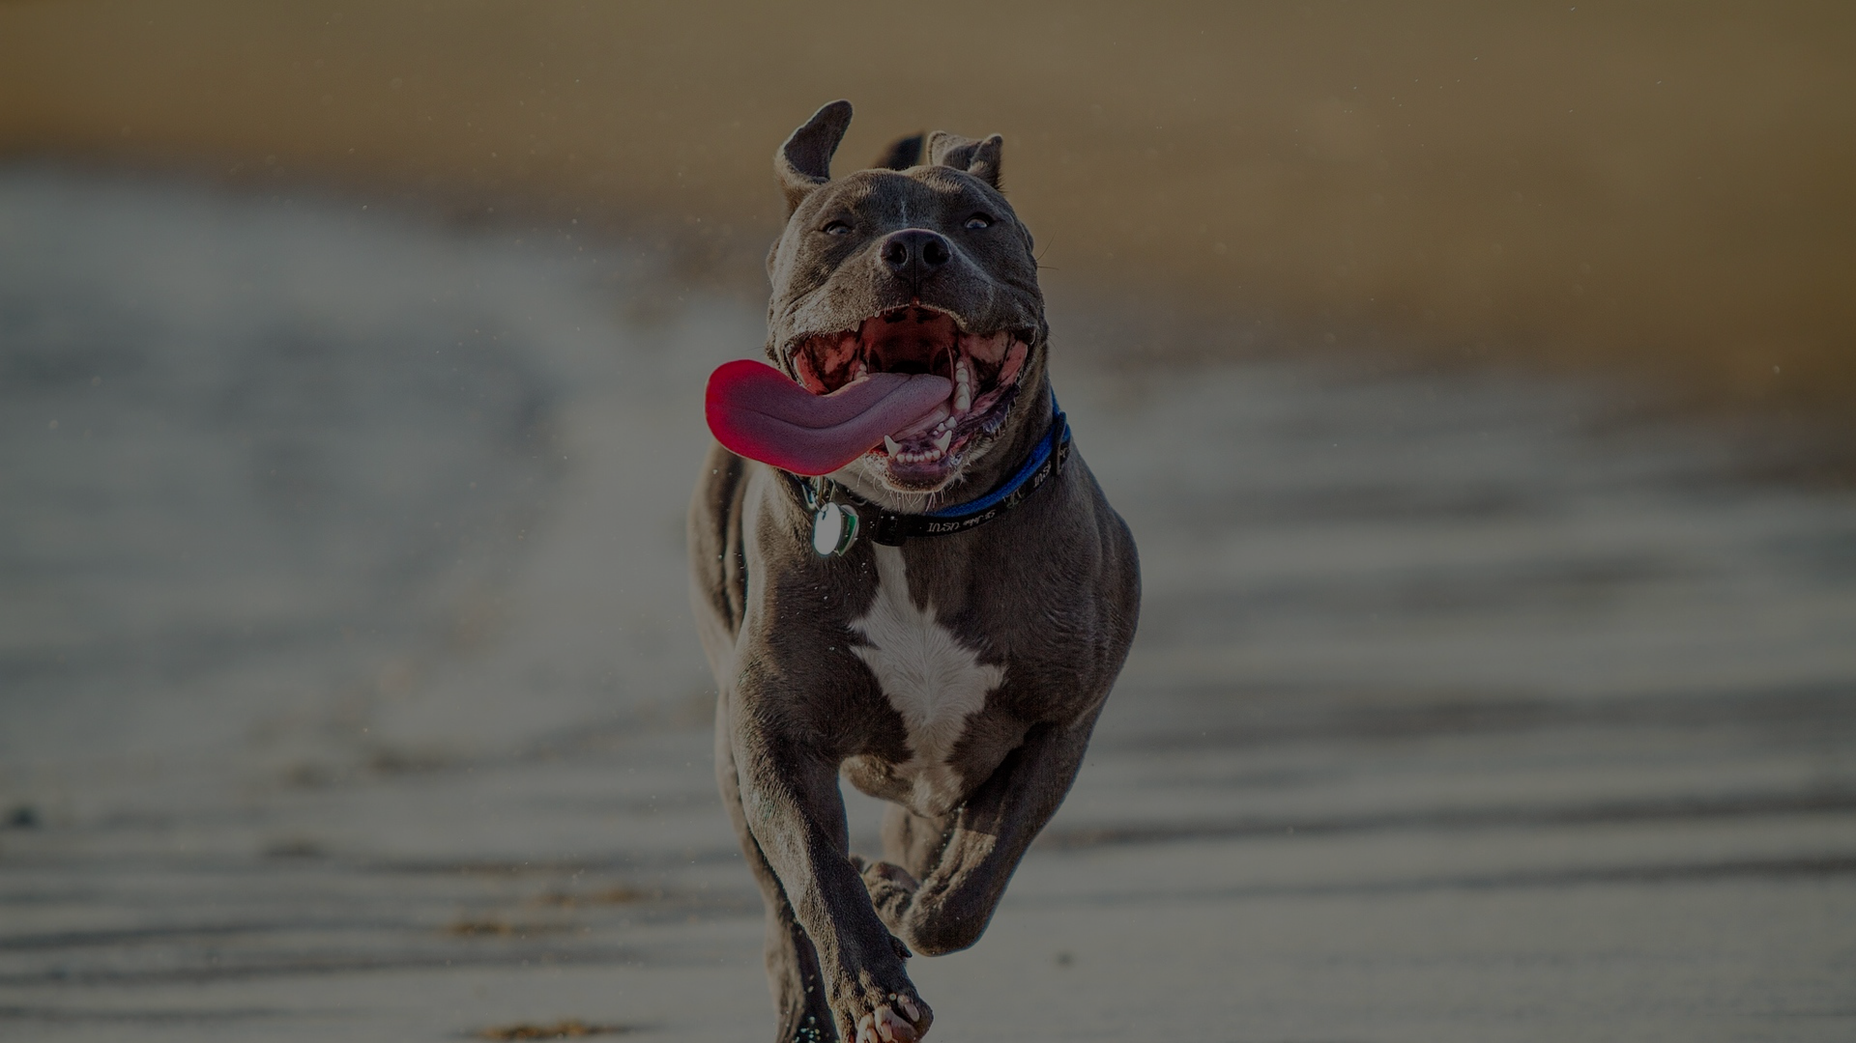
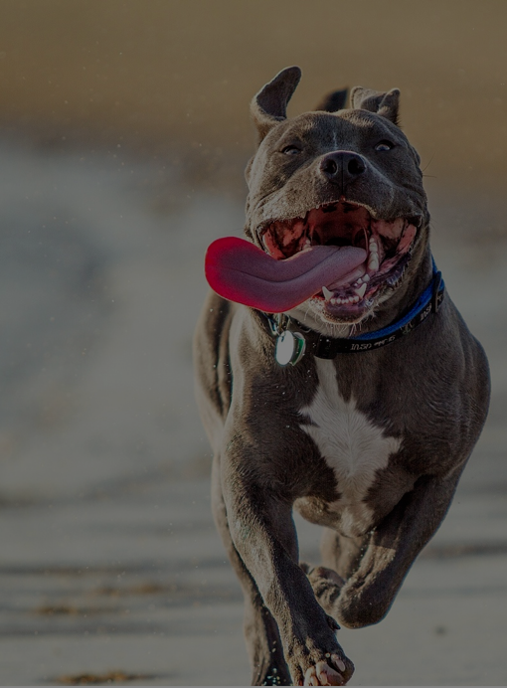
“Any happiness you get you’ve got to make yourself”
-Alice Walker
“Any happiness you get you’ve got to make yourself”
-Alice Walker

Slide 2
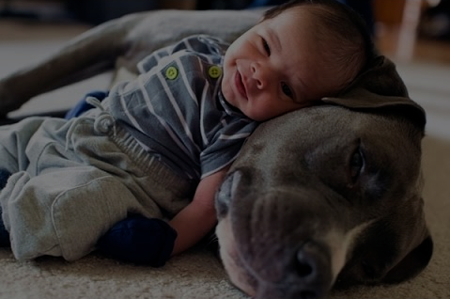
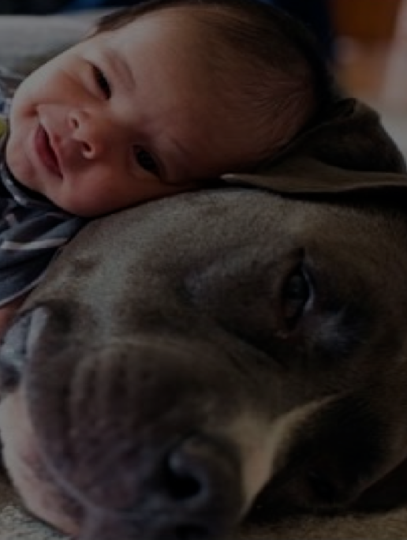
“Life is short, and it’s up to you to make it sweet.”
-Sadie Delany
“Life is short, and it’s up to you to make it sweet.”
-Sadie Delany

Slide 3
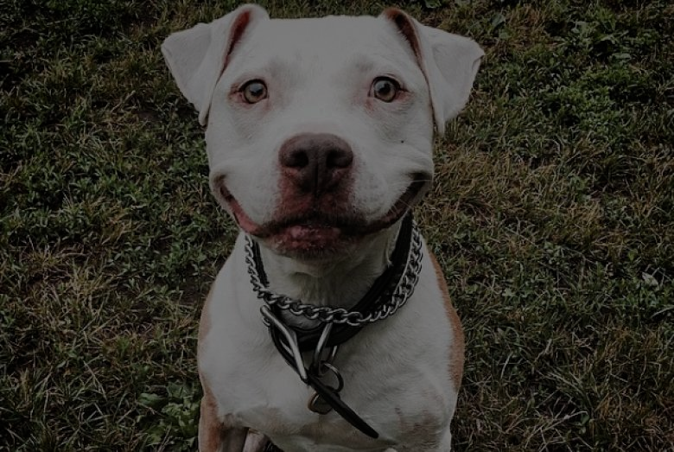
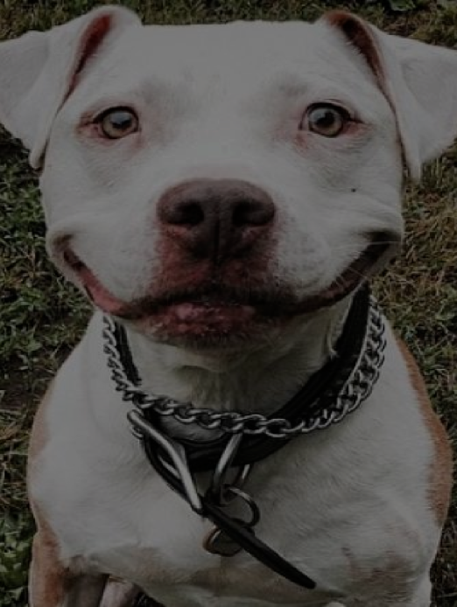
“If you don’t like something, change it. If you can’t change it, change your attitude.”
-Maya Angelou
“If you don’t like something, change it. If you can’t change it, change your attitude.”
-Maya Angelou

